Slide 1
Machine Learning - Coding Challenge - Spring 2025
<Deep Learners>
<Erlisa Lokaj>/<Lorenzo Sciarretta>/<Zakaria Omarar>
Notes:
https://codebox.net/pages/tensorflow-convnet-designer

Slide 2
Agenda
Team Introduction
Deep Neural Network details
Track 1: Custom Model Architecture
Track 2: Pre-Trained Model
Experimental details
Data Pre-Processing & Augmentation
Training and Validation
Semi-Supervised Pseudo-Labeling
Prediction Results
Additional Highlights
Challenges & Insights

Slide 3
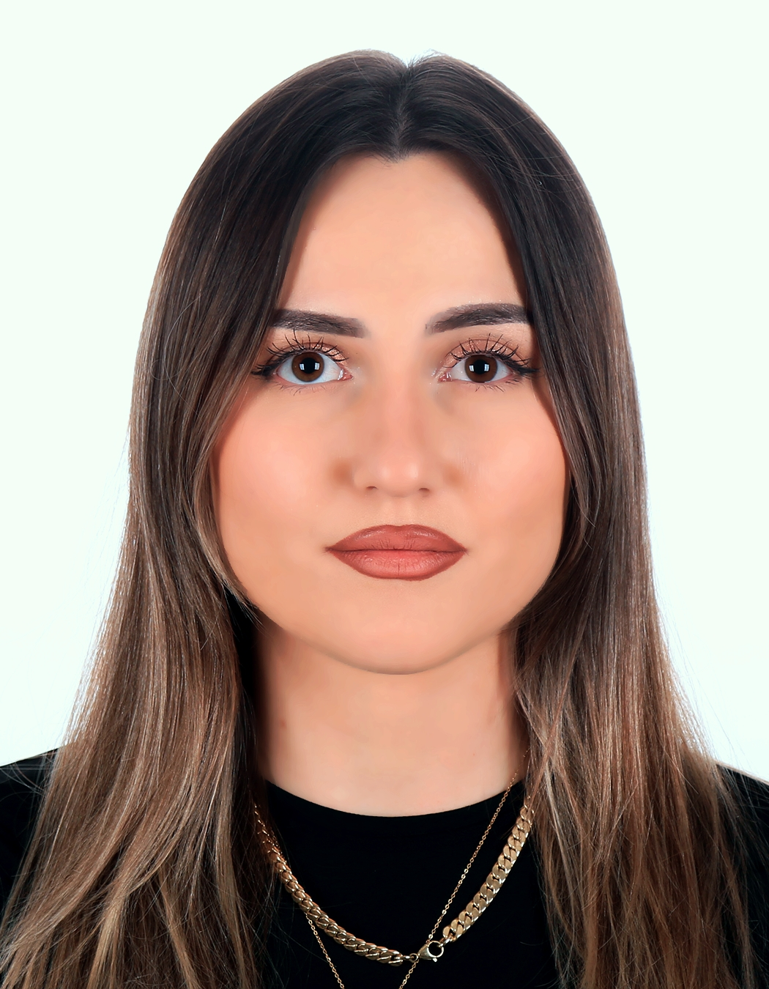
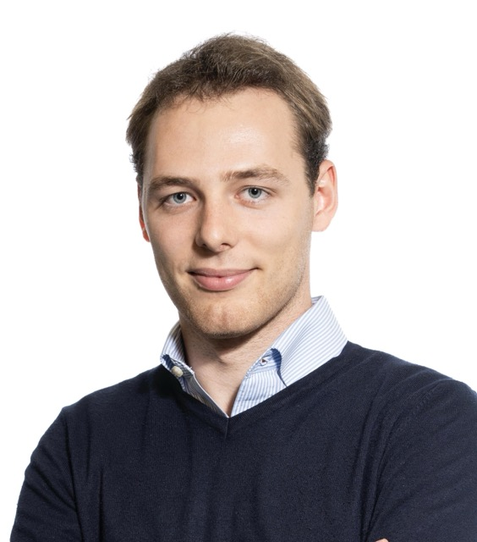
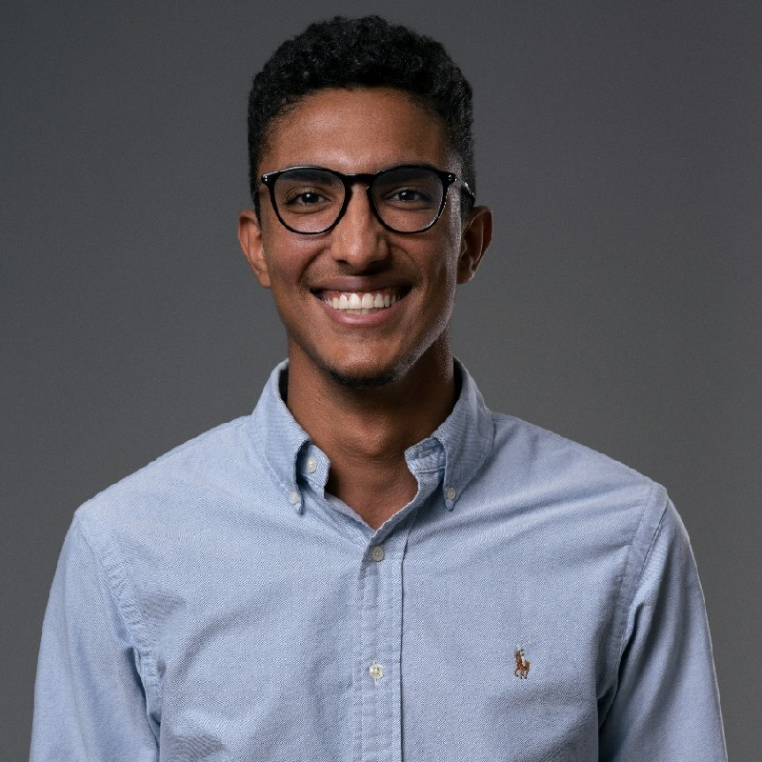
<Team Introduction>
Erlisa Lokaj
MCS
erlisa.lokaj@student.unisg.ch
Lorenzo Sciarretta
MCS
lorenzo.sciarretta@unisg.ch
Zakaria Omarar
MCS
zakaria.omarar@student.unisg.ch

Slide 4
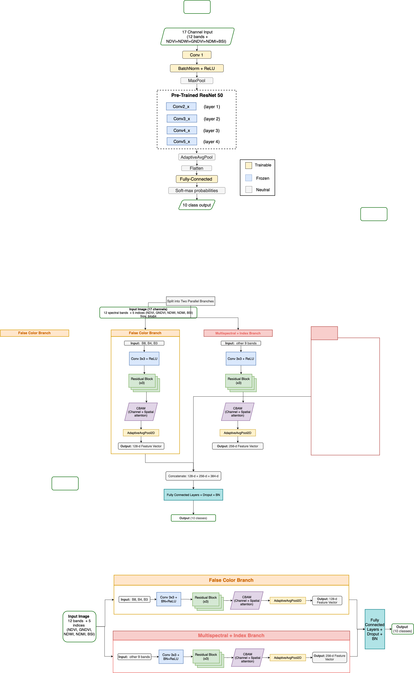
<Track 1: Custom Model Architecture>
CBAM – Convolutional Block Attention Module
BN – Batch Normalization
ReLu – Rectified Linear Unit

Slide 5
<Track 2: Pre-Trained Model>
Why ResNet-50?
- ImageNet-trained backbone
- Lightweight to fine-tune
Tuning:
Replace first layer with new one that accepts the input channels size and initialize it.
Modify last layer with a FC layer with the specific number of classes.

Slide 6
<Data Pre-Processing & Augmentation>
Dataset: EuroSAT multispectral
Band Ordering : Reorder Sentinel-2 bands to canonical sequence and drop B10
Spectral Indices: Compute 5 indices (NDVI, GNDVI, NDWI, NDMI, BSI) → 17-channel tensor
Technique | Purpose
Flips & Rotations | Horizontal/vertical flips, 90° rotations
Spectral Noise | Random band dropout, Gaussian noise
Patch Erasing | Random simulation of clouds/shadows
MixUp & CutMix | Linear & patch-based sample/label interpolation
NDVI - Vegetation Health
GNDVI - Chlorophyll Content
NDWI - Surface Water
NDMI - Vegetation Moisture
BSI - Bare Soil Detection

Slide 7
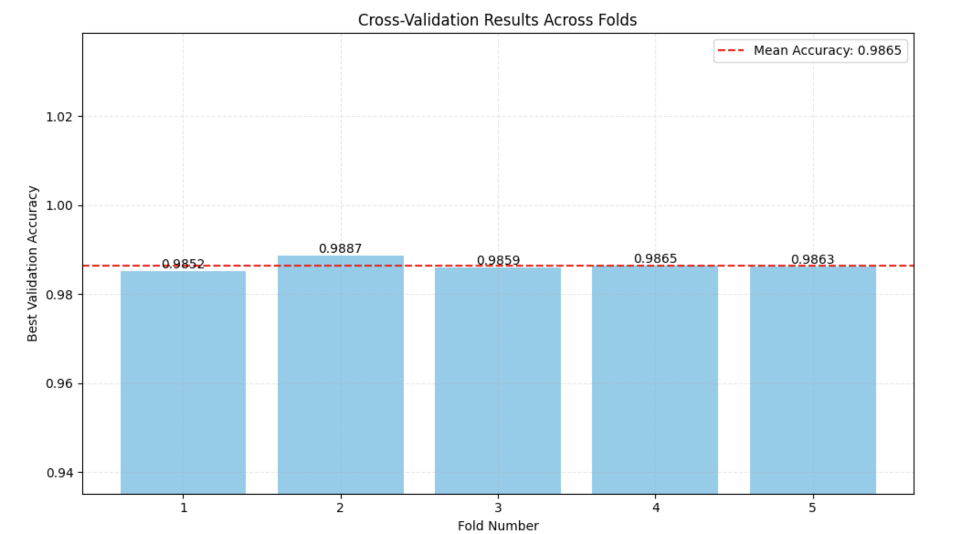
<Training and Validation Track 1>
Data Split: 5-fold stratified cross-validation (80% train/20% val)
Batch size: 32, Optimizer: AdamW (lr=1e-3→1e-5 cosine annealing)
Weight decay: (1e-4), Dropout : (0.4 → 0.2), Early Stopping: Patience = 7 epochs on validation accuracy

Slide 8
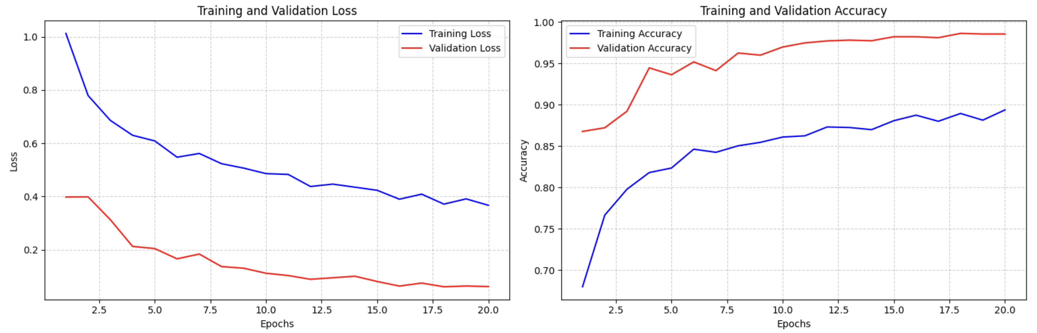
<Training and Validation Track 1>
Training and Validation (Loss/Accuracy) accross epochs

Slide 9
<Semi-Supervised Pseudo-Labeling >
Initial Ensemble Prediction
Adaptive Thresholding
Select High-Confidence Samples
Keep only predictions ≥ threshold for each class
Fine-Tune Models
Repeat
Re-generate pseudo-labels with updated ensemble, iterate twice
Use 5-model ensemble to infer softmax probabilitites on unlabeled test set
Compute class-specific confidence thresholds (0.65–0.98) based on validation accuracies & confusion patterns
Cap at 200 samples/class to prevent imbalance
Combine original labeled data + pseudo-labeled samples
Fine-tune each model for 5 epochs

Slide 10
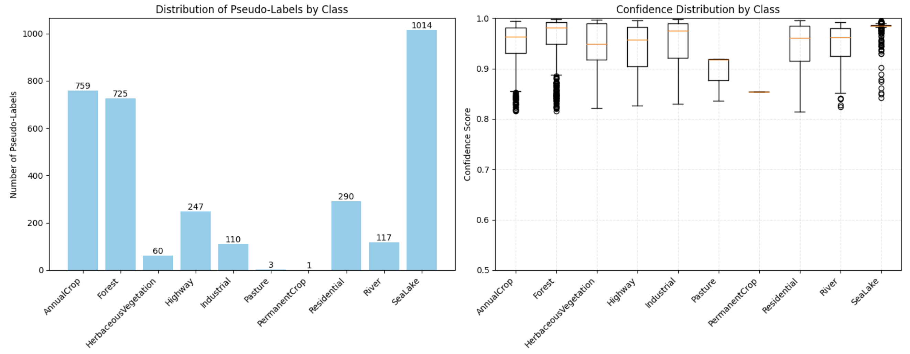
<Semi-Supervised Pseudo-Labeling>
Top Confidence Samples Per Class

Slide 11
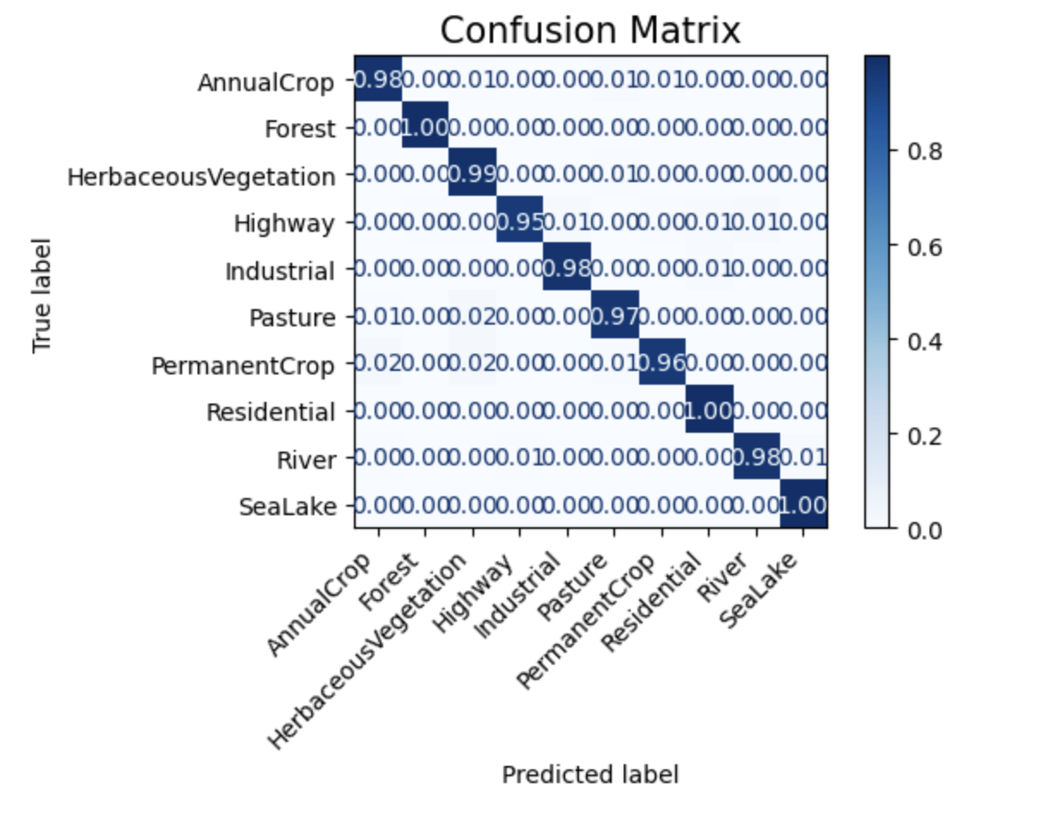
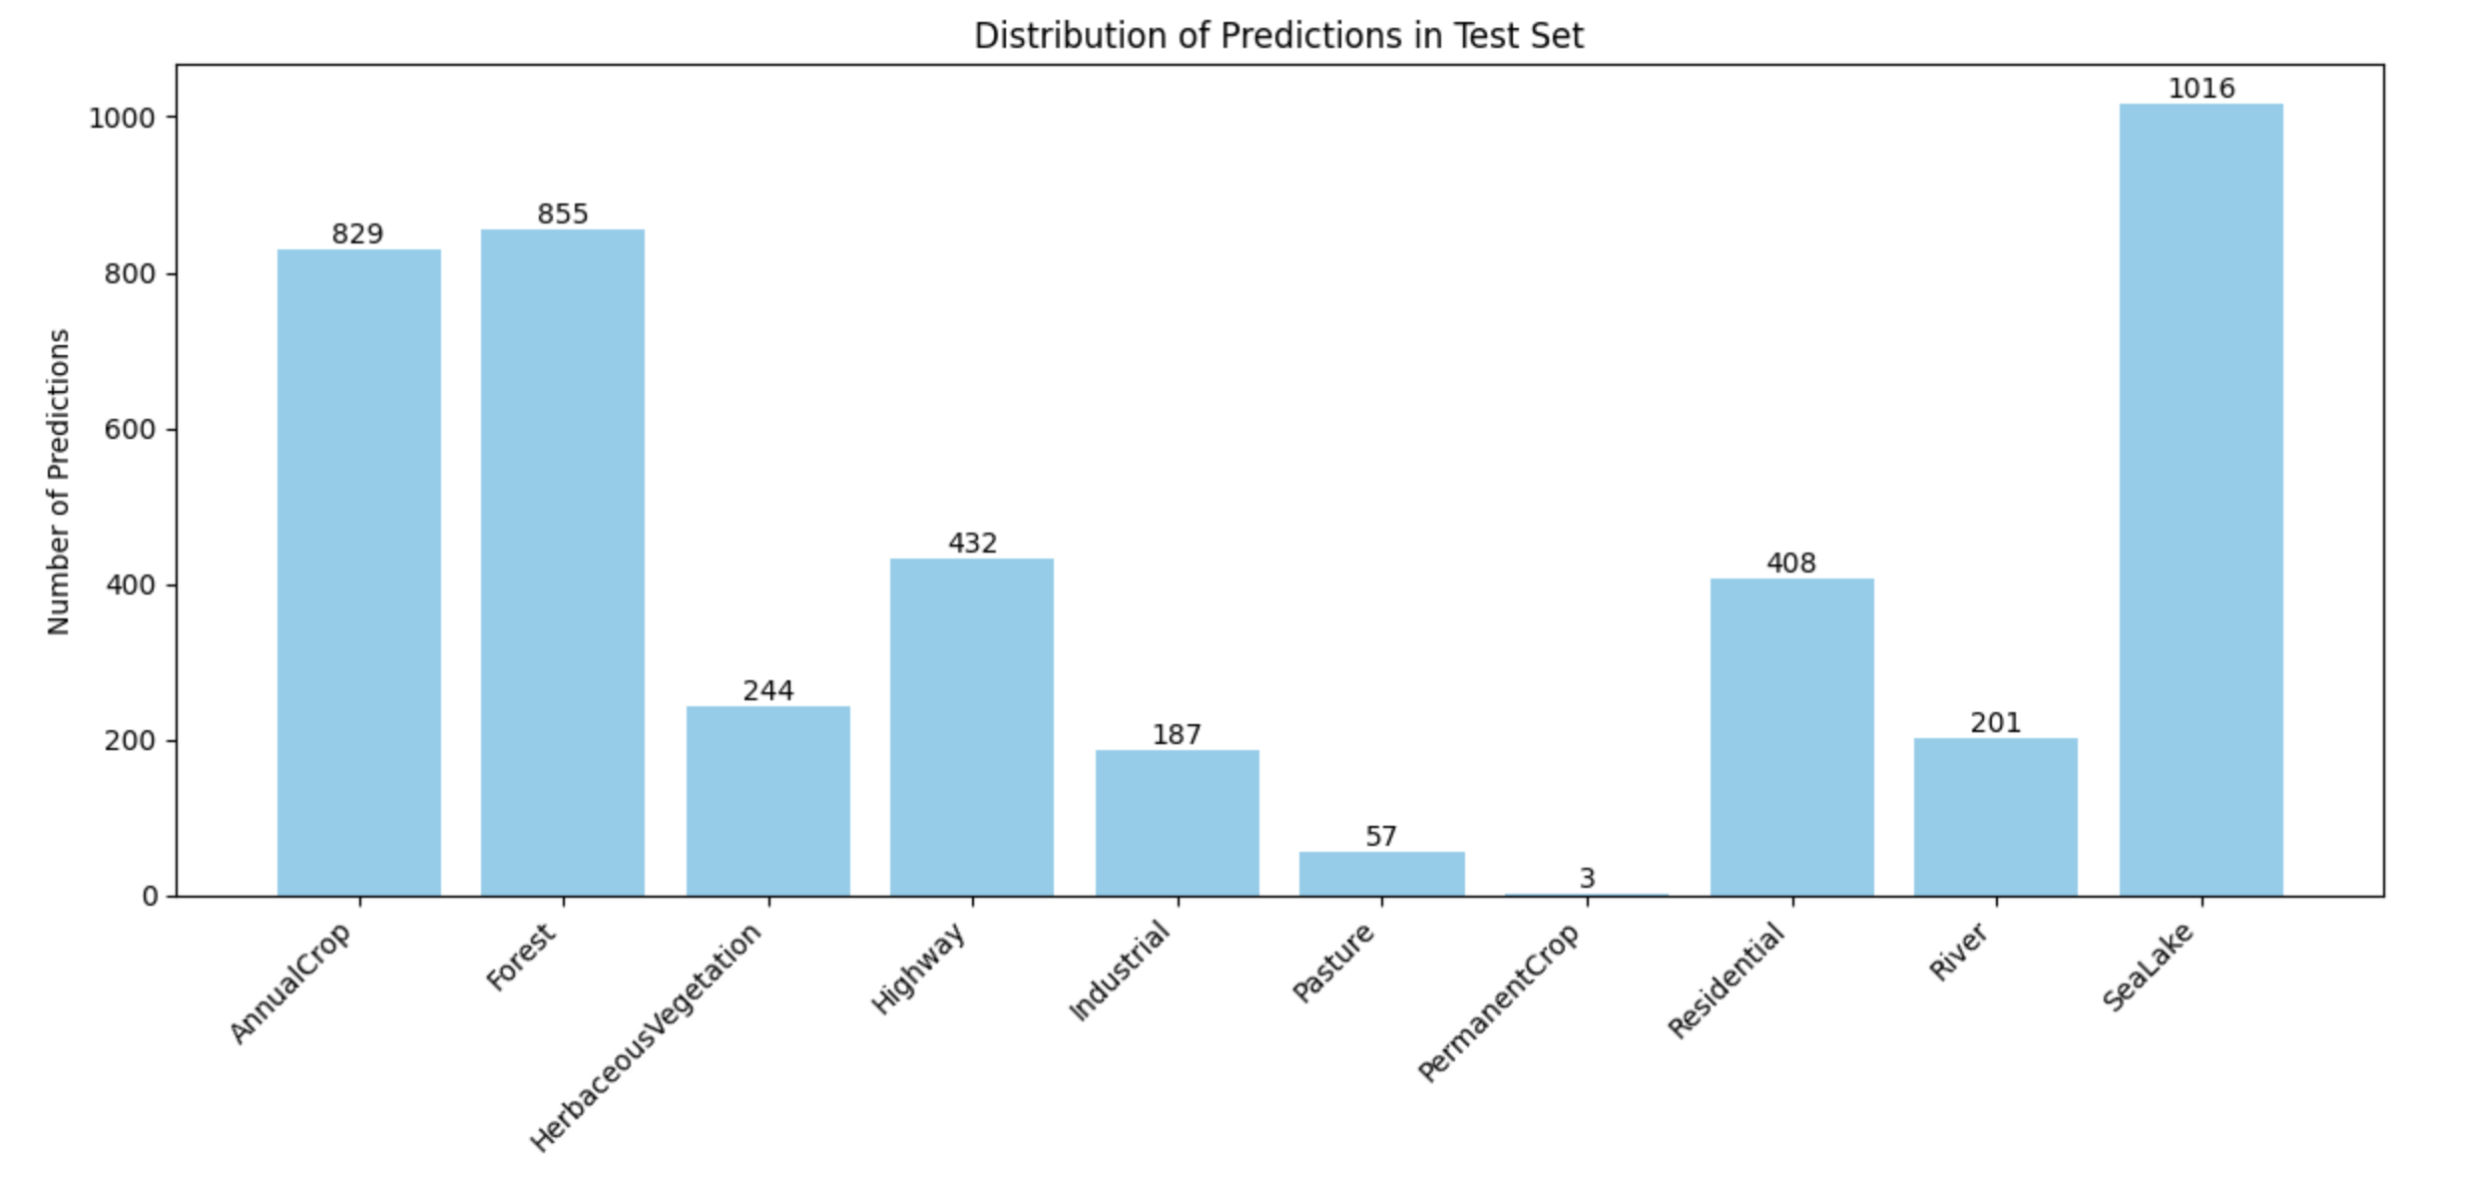
<Prediction Results Track 1>
Test Set Data: 4232 Unlabeled .npy files from test directory
Validation Accuracy: 98%
Final Test Accuracy (Kaggle): 69.6%

Slide 12
<Additional Highlights>
Aspect | Track 1: Fusion Classifier | Track 2: ResNet50
Architecture | Dual-branch CNN with CBAM attention & fusion head | Pretrained ResNet50 backbone,
Input Channels | 12 spectral bands + 5 indices | 12 spectral bands + 5 indices
Key Innovations | • Channel & spatial attention (CBAM) • Spectral-index stacking • MixUp/CutMix | • Leverage ImageNet features • Modify first and last layers
Strengths | • Excels on classes distinguished by spectral signatures • High per-class precision | • Fast convergence • Strong generalization from pretrained filters
Limitations | • More parameters → longer training time • Sensitive to augmentation rates | • Limited to features learned from RGB ImageNet • Slightly lower spectral focus
Kaggle Accuracy | 69.6 % | 59 %

Slide 13
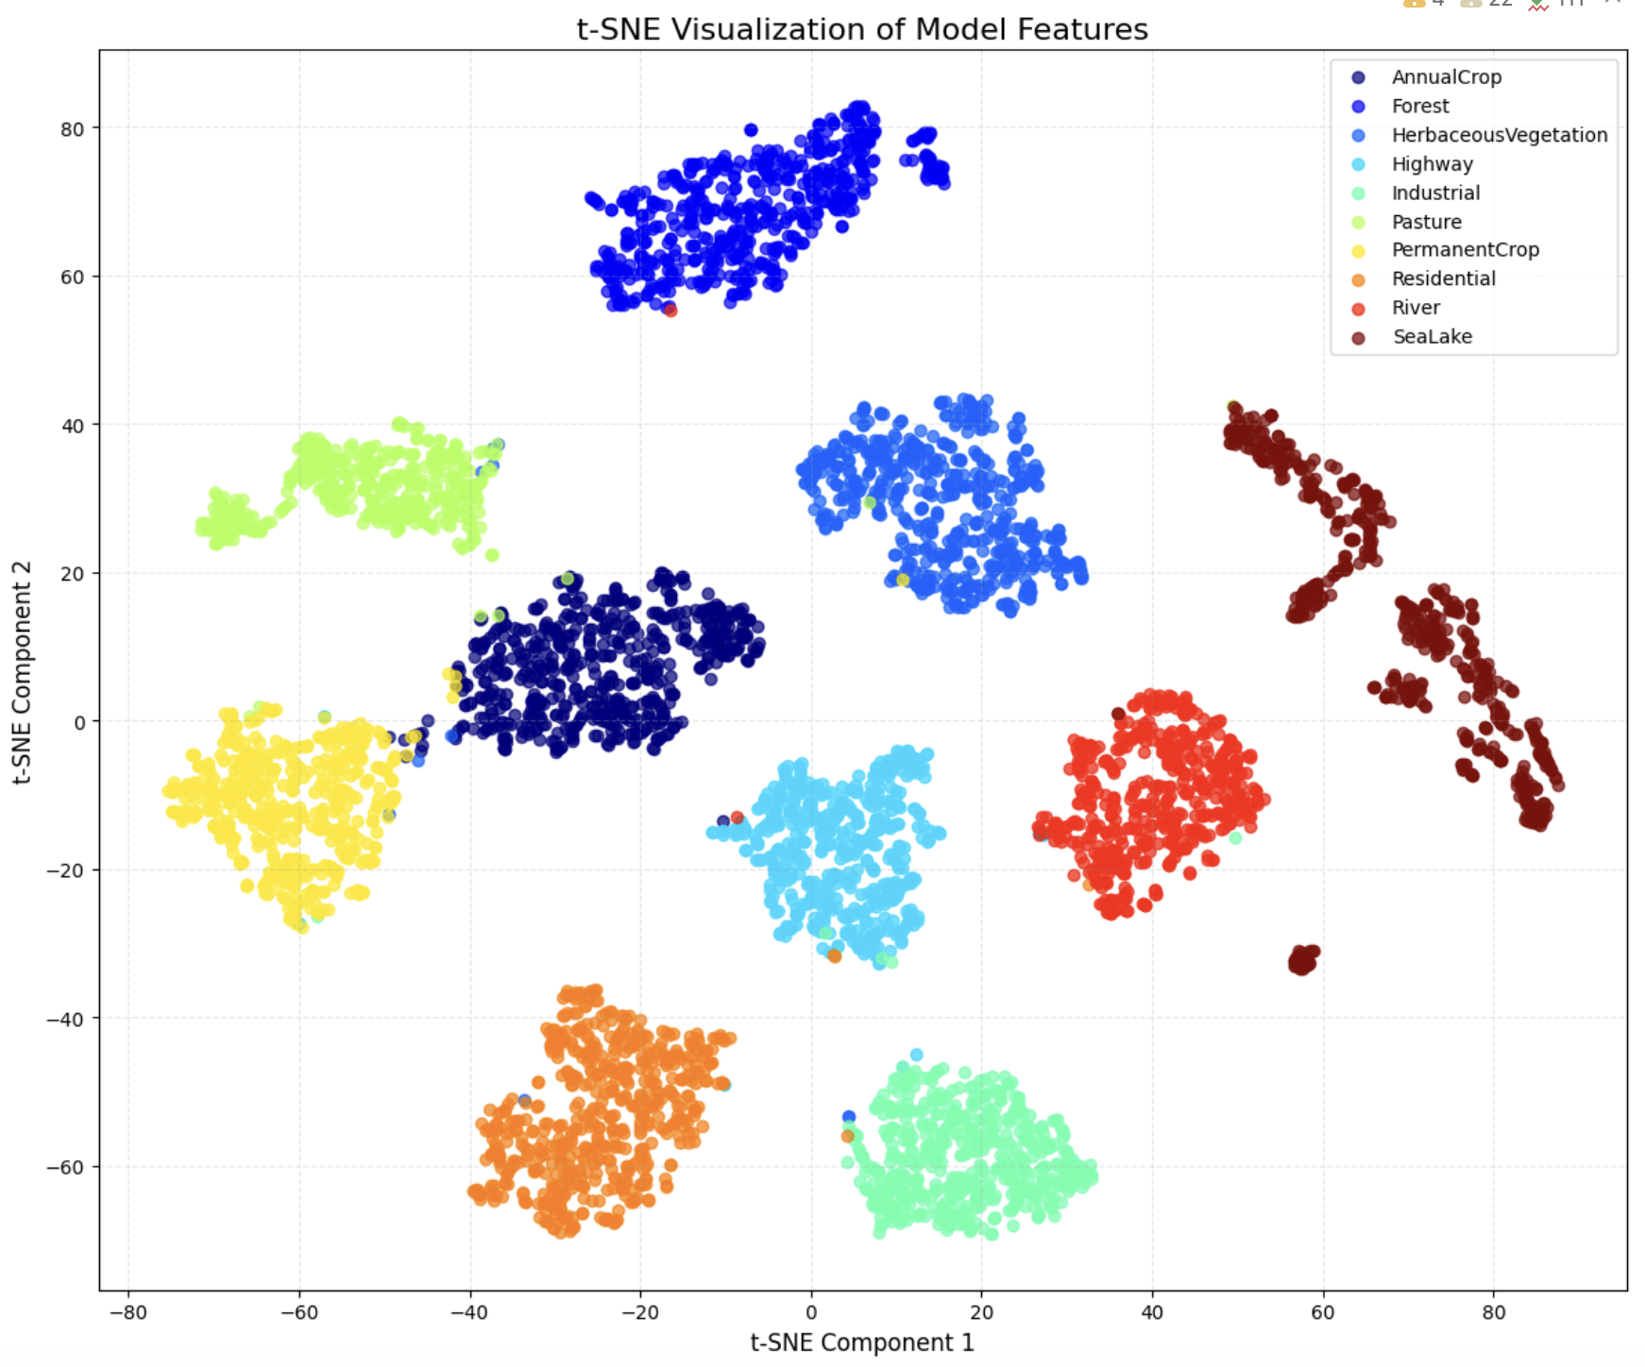
<Additional Highlights>

Slide 14
<Challenges & Insights>
Band Inconsistency: Resolved via explicit band mapping and B10‐band removal.
Spectral Indices Overhead: On-the-fly index computation added pipeline complexity.
Class Imbalance: Rare classes → noisy validation; solved by pseudo-label thresholds.
Augmentation Tuning: Aggressive MixUp/CutMix hurt convergence
Attention Boost: CBAM gave +2–3% lift.
Pseudo-Labeling Trade-off: Gains plateau after 2 iterations; increased accuracy after 2 iterations.

Slide 15
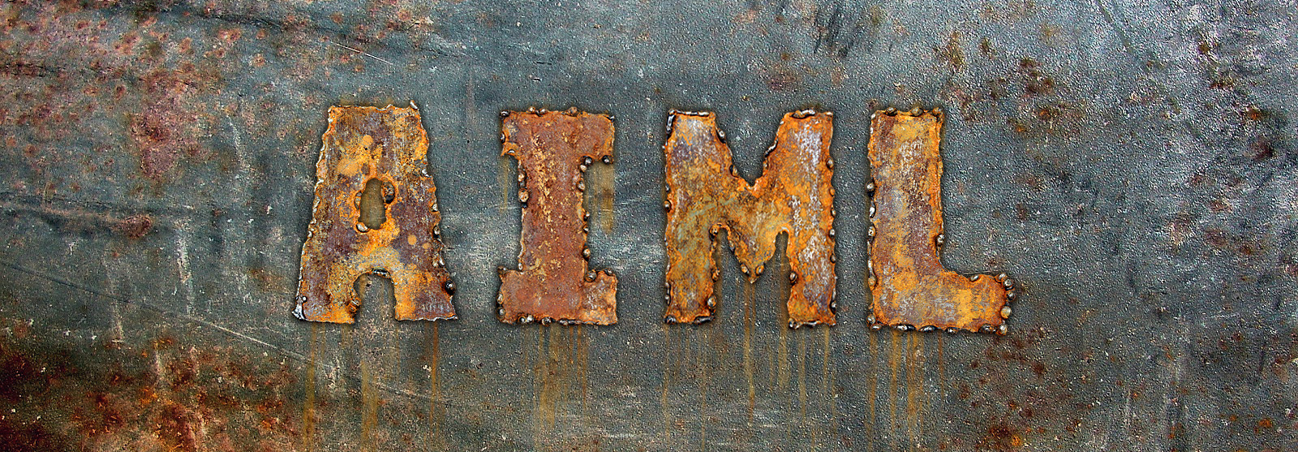
Questions?

